Slide 1
Fine-grained Named Entity Recognition in Frog
A study of (Dutch) foundations
Lilian de Jong 10-4-2019
Supervisor: dr. Iris Hendrickx

Slide 2
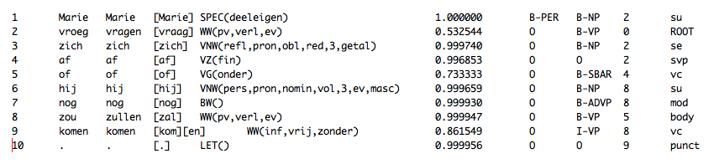
Frog
Integration memory-based NLP modules for Dutch

Slide 3
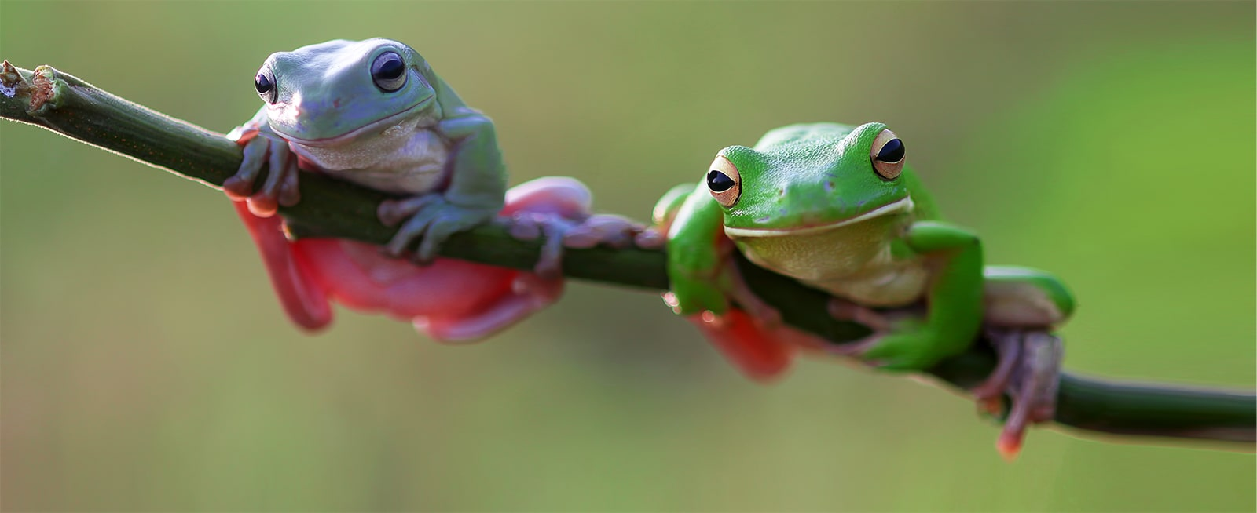
Applicability Frog
Corpus construction --> 500-million-word SoNaR-corpus
Text analytics applications --> Twitter (Aminian et al. 2012)

Slide 4
Named Entity Recognition (NER)
Recognizing and classifying named entities
Labels are application-dependent
Impact of textual genre and domain (Poibeau & Kosseim, 2001)
Person | PER
Organisation | ORG
Location | LOC
Product | PRO
Event | EVE
Miscellaneous | MISC

Slide 5
Named Entity Recognition (NER) in Frog
Memory-based learning
Trained on SoNaR 1-million-word corpus
BIO paradigm: Slachtofferhulp B-org Nederland I-org is O an O organisation O . O

Slide 6
NER in applications
Machine translation (Babych & Hartley, 2003)
Question answering (Toral et al., 2005)

Slide 7
Fine-grained NER
Location --> country, outer space, etc.
Useful for
information retrieval
question answering
the automatic construction of ontologies (Lee et al. 2006)
Challenge: creation of training data

Slide 8
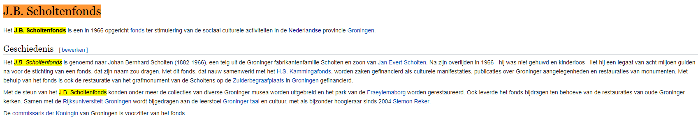
Data source
Category “Dutch foundations” on Wikipedia: 438 articles
First sections + sentences containing foundation name

Slide 9
Cleaning
Strip text from footnotes, infoboxes, images, etc.
Linked NEs are placed between [[ ]]
Before | Taalvoutjes is een [[Nederlandse]] [[stichting]] die [[grappige]] [[spel]]- en [[taalfouten]] verzamelt en publiceert.
After | [[Taalvoutjes]] is een [[Nederlandse]] stichting die grappige spel- en taalfouten verzamelt en publiceert.

Slide 10
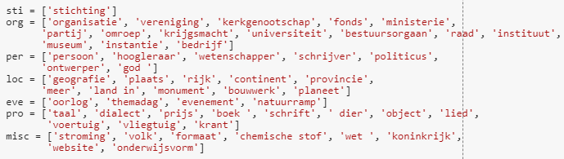
Annotating
Parent categories
Named entity | Parent categories | Label
Radboud Universiteit | Radboud Universiteit Nijmegen, Katholieke universiteit | ORG
Nederlandse Kastelenstichting | Nederlandse stichting | STI
Notes:
If the search algorithm is not able to determine the label due to no rules applying, it looks at the parent categories of the parent categories and repeats this step until a rule applies.

Slide 11
Dataset
438 --> 530 foundations
Train (80%), develop (10%) and test (10%) set
 | Articles | Sentences | Tokens
Training set | 424 | 2930 | 65750
Development set | 53 | 386 | 9829
Test set | 53 | 381 | 8300
 | EVE | LOC | MISC | ORG | PER | PRO | STI
Training set | 72 | 948 | 117 | 372 | 210 | 123 | 1312
Development set | 10 | 204 | 43 | 99 | 186 | 72 | 354
Test set | 19 | 235 | 54 | 102 | 83 | 50 | 273

Slide 12
Results
Accuracy = 89%
 |  | Precision | Recall | F
Development set | overall | 39,88 | 40,38 | 40,12
 | foundations | 13,84 | 62,82 | 22,69
Test set | overall | 42,67 | 44,23 | 43,43
 | foundations | 18,32 | 60,24 | 28,09

Slide 13
Future directions
Possible ways of improvement:
Use of gazetteers
More diverse data
Feature selection

Slide 14
References
Aminian, M., Avontuur, T., Balemans, I., Elshof, L., Newell, R., van Noord, N. J. E., ... Azar, E. Z. (2012). Assigning part-of-speech to Dutch tweets. In M. Melero (Ed.), Proceedings of the LREC workshop: @NLP can u tag #user_generated_content?!, Istanbul, Turkey (pp. 9-14). s.l.: [s.n.].
Bogdan Babych and Anthony Hartley. (2003). Improving Machine Translation Quality with Automatic Named Entity Recognition. In Proc. of EACL-EAMT. Budapest.
https://ivdnt.org/downloads/tstc-sonar-corpus
Lee, C.; Hwang, Y.; Oh, H.; Lim, S.; Heo, J.; Lee, C.; Kim, H.; Wang, J.; and Jang, M. (2006). Fine-grained named entity recognition using conditional random fields for question answering. Information Retrieval Technology pp. 581–587.
Poibeau, Thierry; Kosseim, L. (2001). Proper Name Extraction from Non-Journalistic Texts. In Proc. Computational Linguistics in the Netherlands.
Toral, A., Noguera, E., Llopis, F, and Muñoz, R. (2005). Improving question answering using named entity recognition. In NLDB, pp. 181–191
Van den Bosch, A., Busser, G.J., Daelemans, W., and Canisius, S. (2007). An efficient memory-based morphosyntactic tagger and parser for Dutch, In F. van Eynde, P. Dirix, I. Schuurman, and V. Vandeghinste (Eds.), Selected Papers of the 17th Computational Linguistics in the Netherlands Meeting, Leuven, Belgium, pp. 99-114

